Slide 1

Digital Portfolio
STUDENT NAME : p.kayathri
REGISTER NO AND NMID: 2422k2181/AEFA0CC901B90DDA7D34DE2451A9A041
DEPARTMENT : COMPUTER SCIENCE
COLLEGE : PURATCHI THALAIVI AMMA ARTS AND SCIENCE COLLEGE/ BHARATHIAI UNIVERSITY

Slide 2

PROJECT TITLE
Create portfolio

Slide 3


AGENDA
Problem Statement
Project Overview
End Users
Tools and Technologies
Portfolio design and Layout
Features and Functionality
Results and Screenshots
Conclusion
Github Link
3/21/2024 Annual Review

Slide 4

PROBLEM STATEMENT
"Our investment portfolio is underperforming and lacks diversification, increasing risk and potential losses. We need to optimize our portfolio to achieve financial goals while minimizing risk."

Slide 5

PROJECT OVERVIEW
"Optimize investment portfolio to achieve financial goals while minimizing risk. Analyze current portfolio, develop customized strategy, and implement optimized portfolio for improved performance and reduced risk."

Slide 6

WHO ARE THE END USERS?
- Individual investors - Financial advisors - Wealth managers - Institutional investors These users utilize portfolios to track performance, make informed decisions, and manage risk.

Slide 7

TOOLS AND TECHNIQUES
Html : structure ( pages, section)
Java :styling ( color, reponsiveness, layouts)
Css:interactivity (nagativation menu, animation, form validation)

Slide 8

POTFOLIO DESIGN AND LAYOUT
- *Clean and minimalistic design* - *Easy navigation* - *Showcasing projects and works* - *Consistent typography and color scheme* - *Responsive design for mobile and desktop*
8

Slide 9
FEATURES AND FUNCTIONALITY
- *Project showcase* - *Responsive design* - *Easy navigation* - *Customization options* - *Performance tracking* (for investment portfolios)

Slide 10
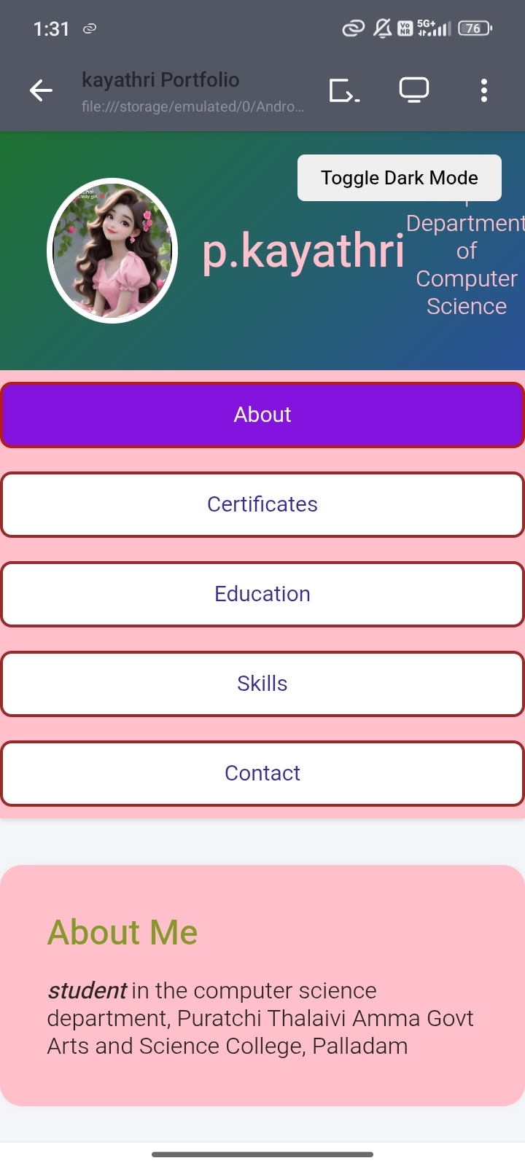
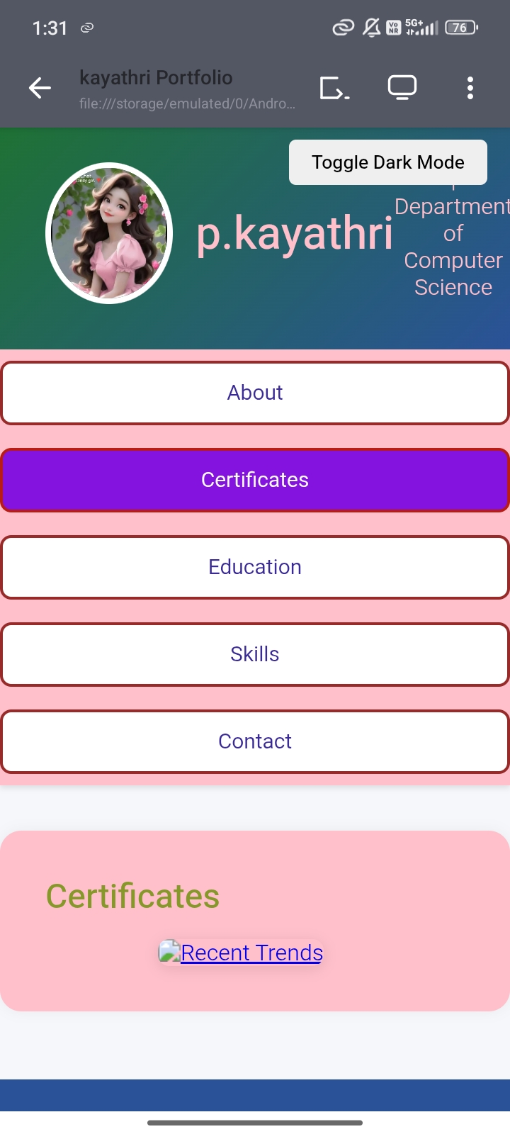
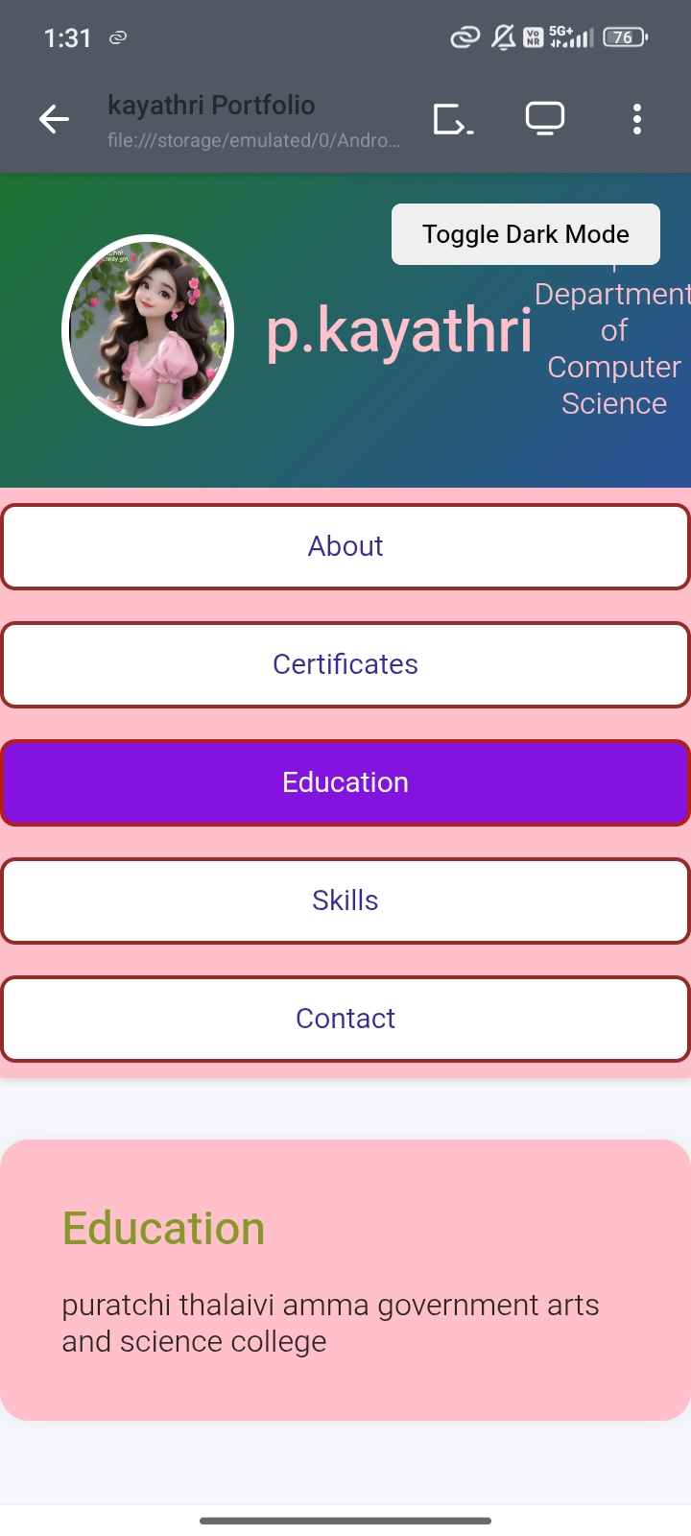
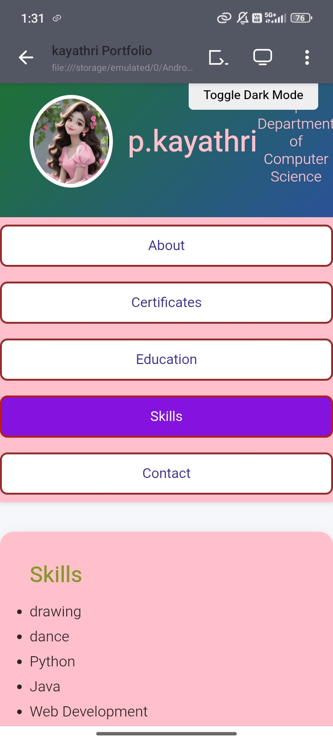
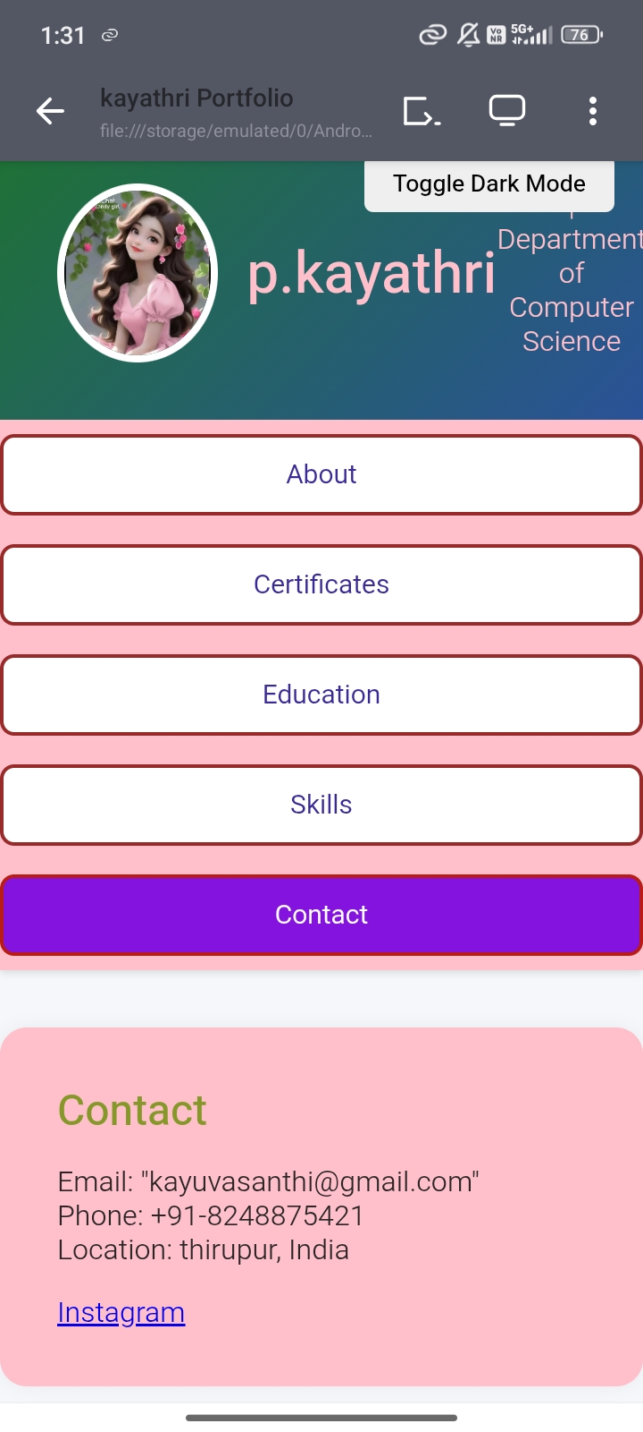

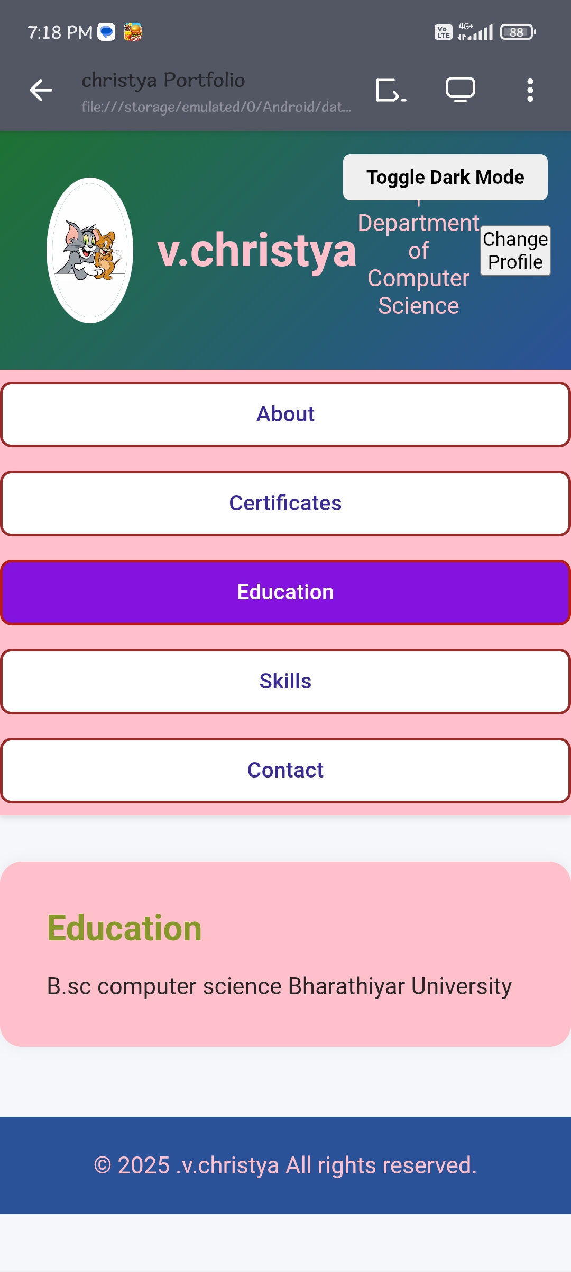
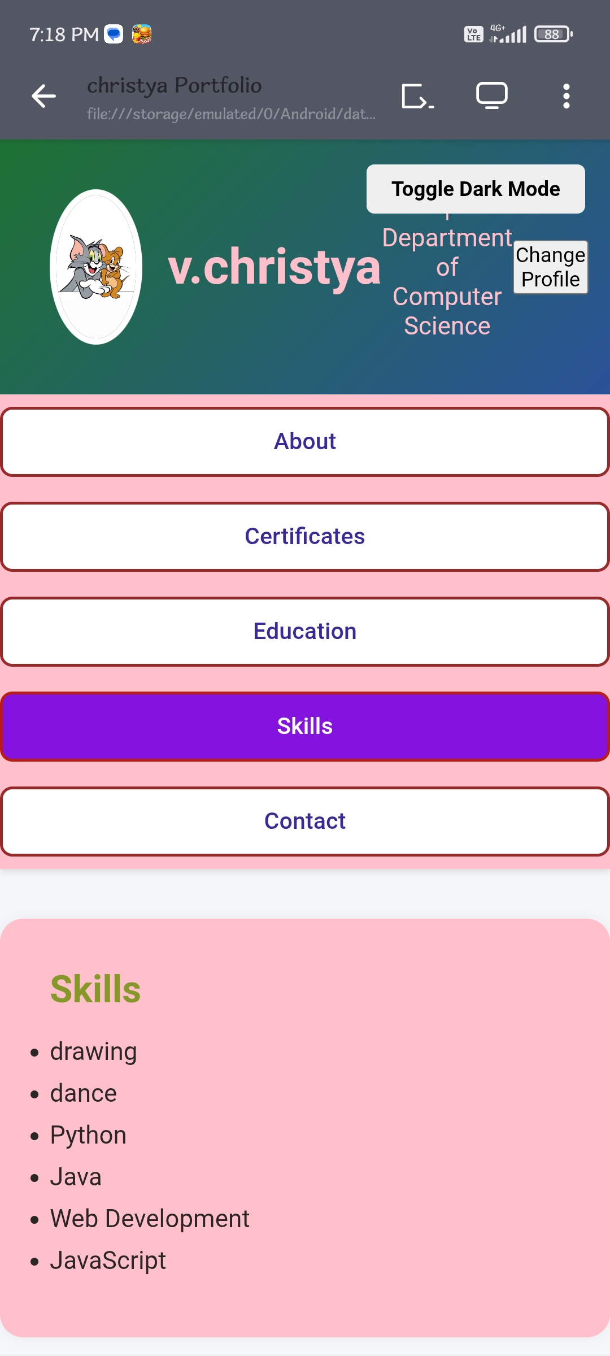
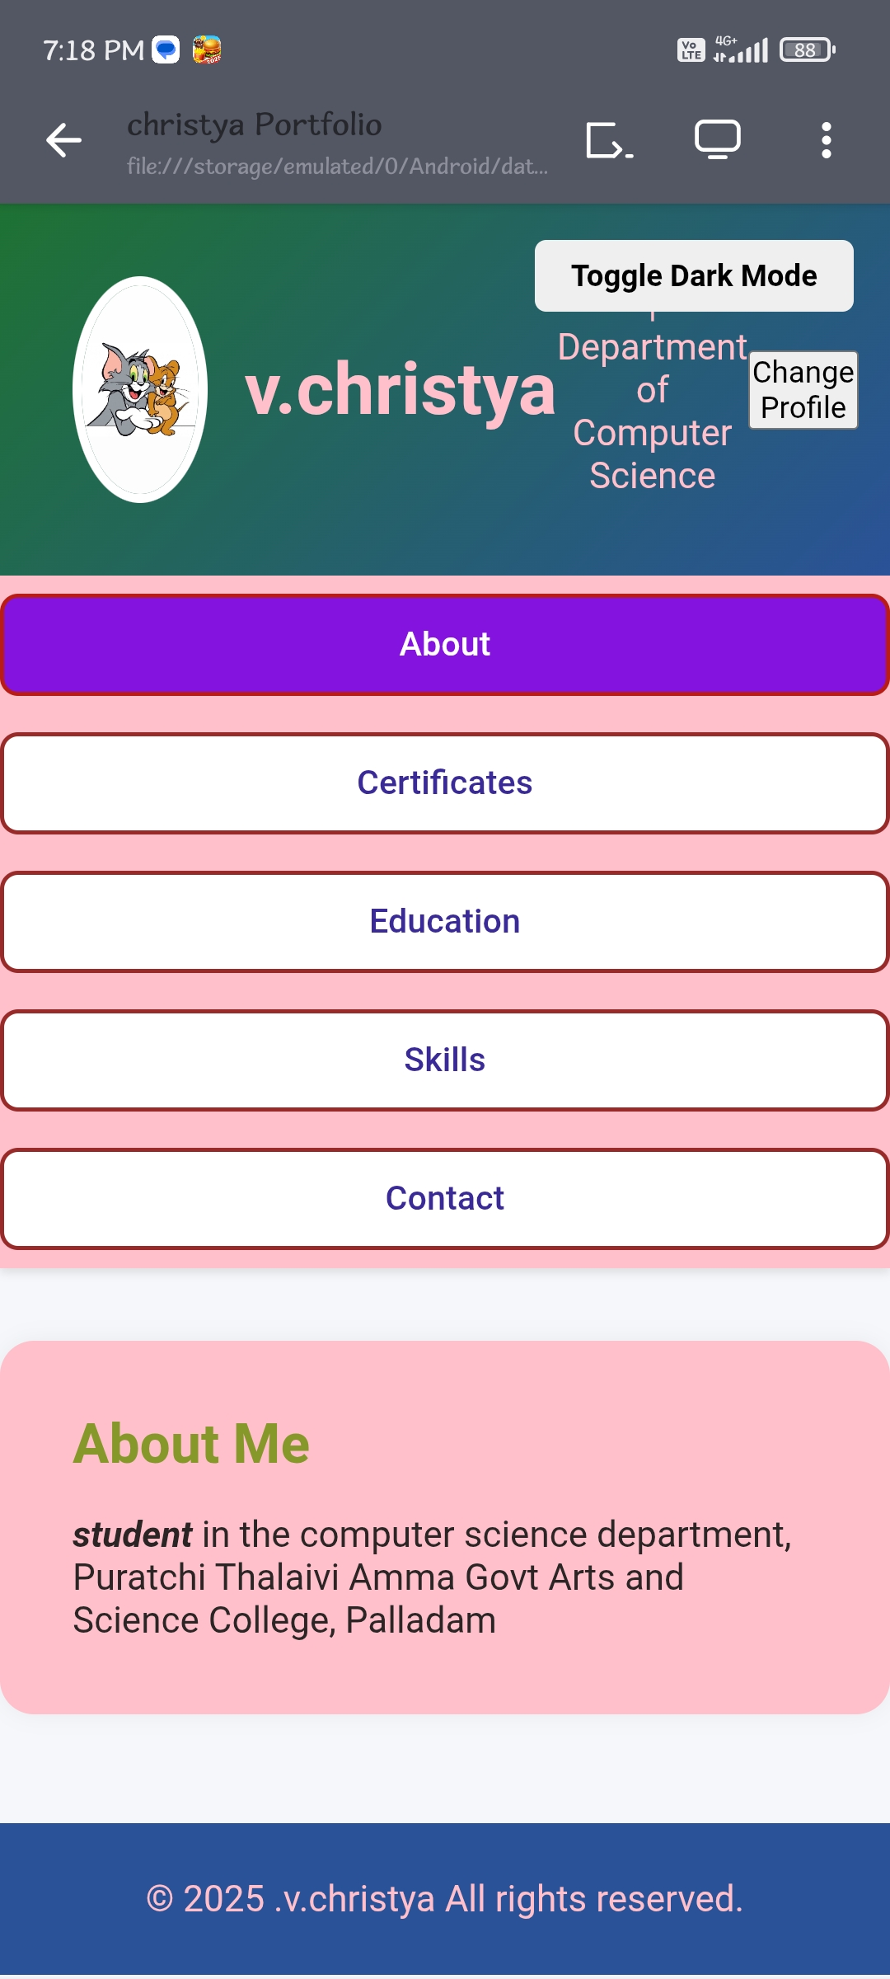
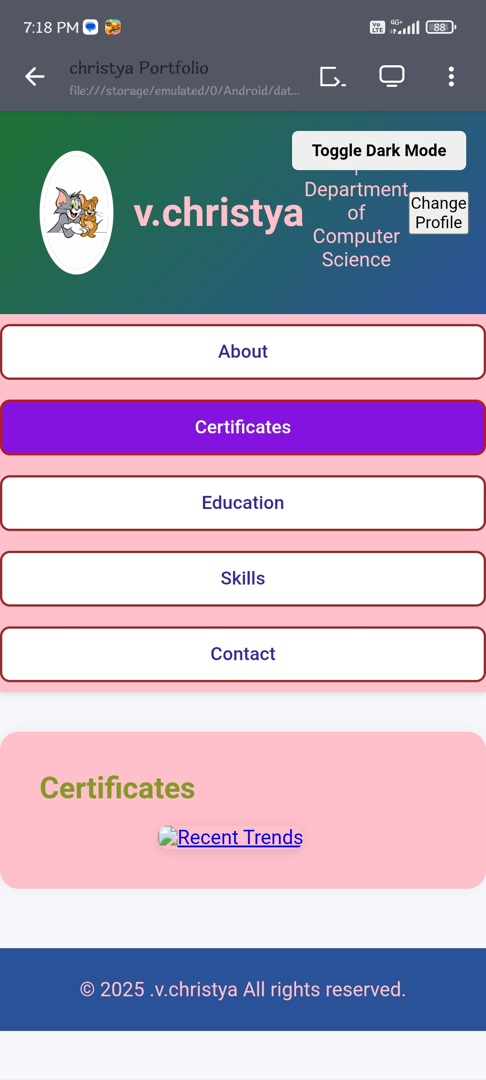
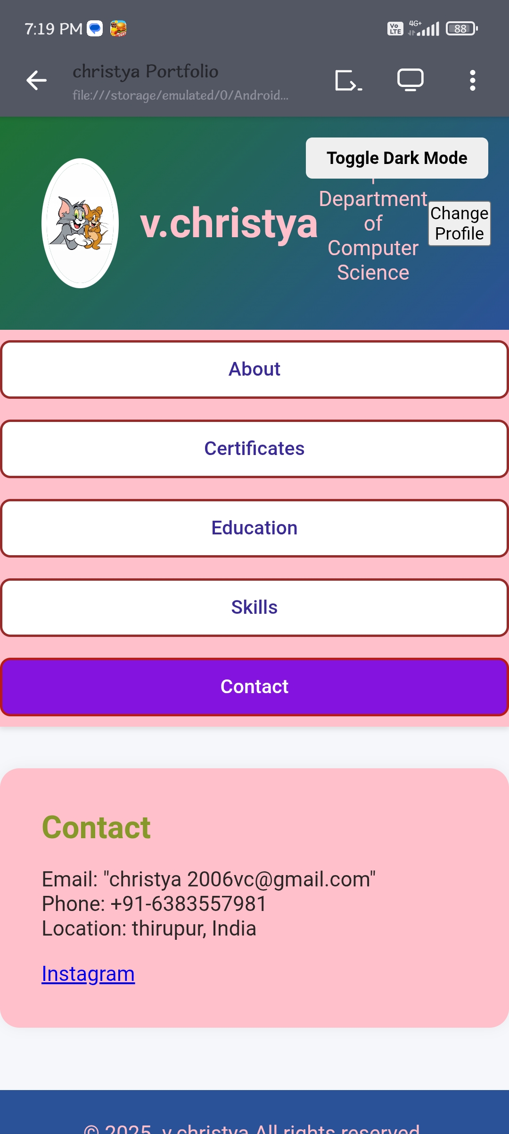
RESULTS AND SCREENSHOTS
3/21/2024 Annual Review
10

Slide 11
CONCLUSION
A well-crafted portfolio effectively showcases skills, experience, and accomplishments, helping individuals or businesses stand out and achieve their goals. It's a powerful tool for career advancement, investment management, or personal branding.
11

